Slide 1
SIMATS ENGINEERING (SAVEETHA SCHOOL OF ENGINEERING)
Department of Computer Science and Engineering
ASSESSMENT TOOL 2 – Concept Mapping
Course Code: | CSA0309 | Course Title: |  | Data Structures
CO Assessed: | CO1 – Imitation (BL3, BL4) | Assessment: |  | Assessment Tool 2 – Concept Mapping
Weightage: | 35% of CIA | Total Marks: |  | 100
CO1 Statement: | Apply suitable data structures and ADTs for efficient problem solving by analyzing time and space complexity.
Student Name: | JEEVA RAGHUL .M |  | Reg. No.: | 192524487
Section / Batch: | B-Tech AIDS |  | Date: | 08/07/2026
Code of Conduct
I (Name / Reg No) certify that this submission is my original work and that I have adhered to the guidelines specified for this assessment. I understand that any violation of academic integrity rules will result in disciplinary action.
Signature of the Student:
Instructions
This test contains 5 Concept mapping questions. Total: 100 Marks.
When a student answer using a concept map, in evaluation the answer should be with following four requirements: Understanding of concepts, Connections between ideas, Logical structure, Clarity of representation.
No negative marking. Unanswered questions carry zero marks.
Section / Topic | Focus | Q Nos | Marks
Linked data structure | Basic data structure | 1 | 20
Primitive and Non-Primitive Data Structure - Linear and Non-Linear Data Structure | Classifications of Linear data structure | 2 | 20
Search Data Structure | Linear Search and Binary Search | 3 | 20
Recursion, Performance analysis | Recursion | 4 | 20
Tree Data Structures | Classifications of Tree data structure | 5 | 20
GRAND TOTAL: |  | 100 Marks

Slide 2
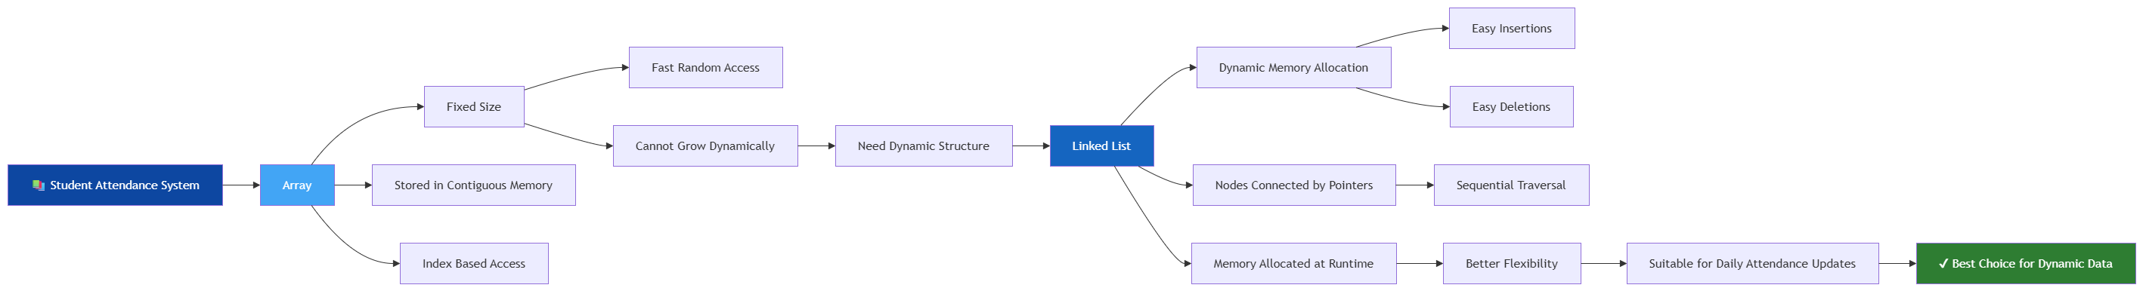

Slide 3
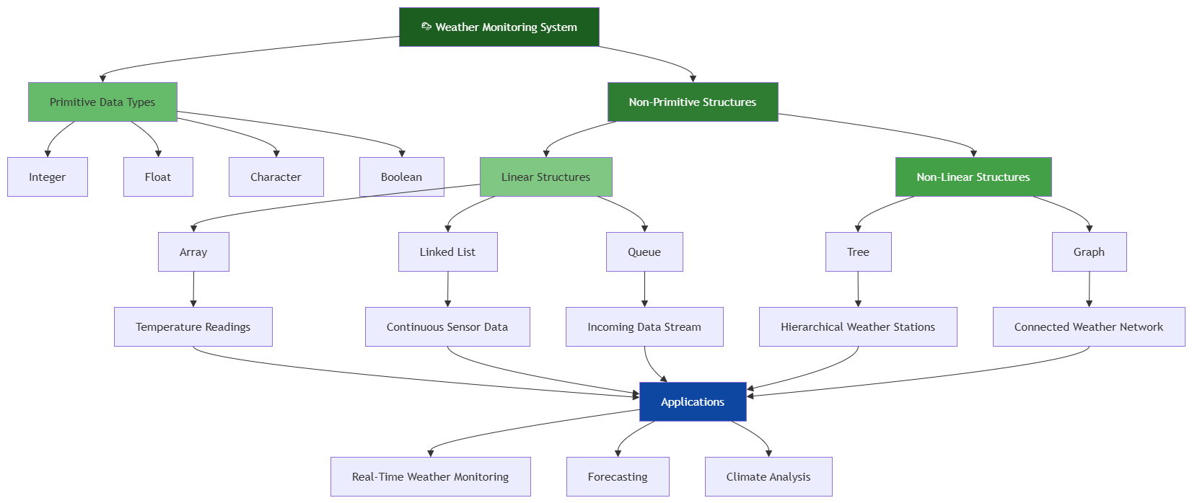

Slide 5
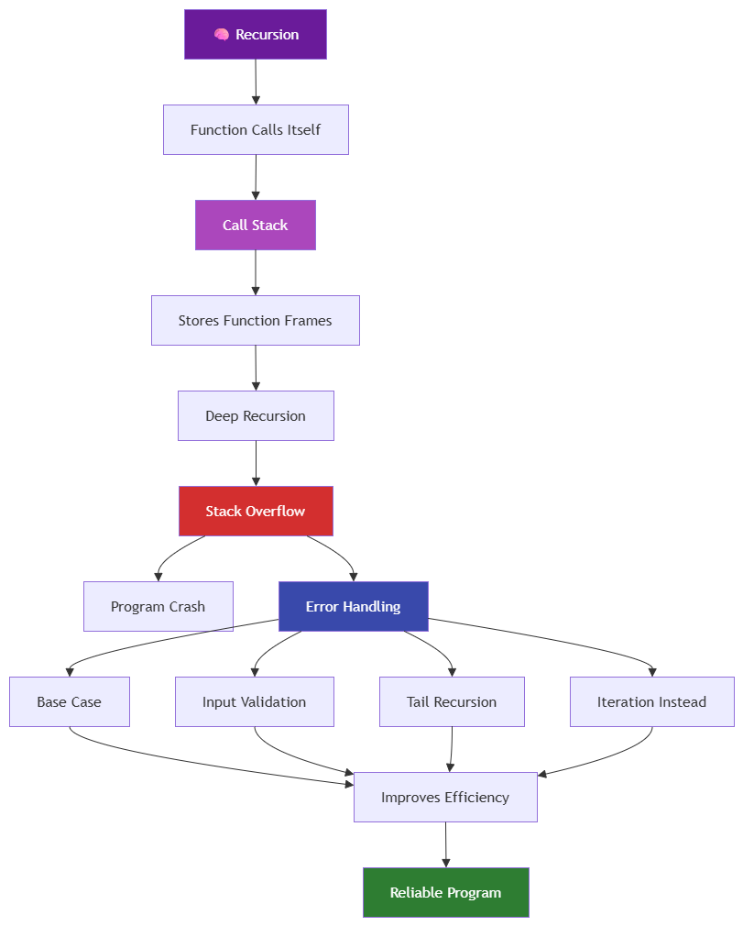

Slide 6
